Slide 1
YOUTUBE VIDEO SUMMARIZER
Sharini U
KGISL Institute Of Technology NM ID: au711721243098
4/10/2024Annual Review
1

Slide 2


AGENDA
Problem Statement Project Overview
Who are the end users
Solution and its value propostion Solution
Modelling Results
4/10/2024Annual Review
3

Slide 3

PROBLEM STATEMENT
Users frequently encounter an overwhelming amount of information while navigating numerous videos on YouTube, leading to difficulties in pinpointing relevant content.
Conventional summarization approaches, like manual note-taking, prove to be laborious and ineffective, impeding productivity.
Concerns surrounding accessibility persist, as numerous videos lack precise transcriptions or subtitles, thereby restricting access for individuals with disabilities.

Slide 4

PROJECT OVERVIEW
Objective:
Developing a YouTube video summarization application to streamline content consumption and enhance accessibility, addressing the diverse needs and preferences of users.
Future Directions:
Improving Summarization Accuracy: Continuously enhancing algorithms to achieve greater precision, particularly in challenging or nuanced contexts.
Integration with Content Platforms: Forging collaborations with content platforms to seamlessly embed the summarization tool, enriching user interaction and involvement.
Personalization Features: Introducing functionalities for personalized summarization options, empowering users to tailor summaries to their individual interests and priorities.
Keys:
YouTube Video Summarization: Employing advanced natural language processing and AI methodologies to distill essential insights and information from YouTube videos.
Language Comprehension: Analyzing video content to extract pertinent details and produce coherent summaries tailored to user preferences.
Real-time Processing: Facilitating immediate summarization outcomes, furnishing users with timely and actionable insights to elevate their content consumption experience.

Slide 5
WHO ARE THE END USERS?
Content Producers and Marketing Professionals: YouTube channel proprietors, advertising specialists, content developers, and digital strategists. They employ the tool to scrutinize trends, audience engagement, and content effectiveness to refine marketing strategies and content creation endeavors.
Educators and Scholars: Instructors, lecturers, learners, scholars, and academic establishments. They employ condensed YouTube videos for educational, investigative, and scholarly pursuits, streamlining knowledge acquisition and dissemination processes.
General Audiences: Public at large, YouTube visitors, individuals seeking knowledge or entertainment. They utilize the tool to economize time and enrich content consumption experiences by promptly accessing condensed YouTube videos for informational or recreational purposes.
Advocates for Accessibility: Persons with disabilities, champions for accessibility, organizations advocating for digital inclusivity. They ensure equitable access to information by employing condensed YouTube videos with precise transcriptions and captions, advancing digital inclusivity and accessibility initiatives.

Slide 6

YOUR SOLUTION AND ITS VALUE PROPOSITION
High Precision and Dependability:
Our YouTube video summarization algorithm employs cutting-edge natural language processing methodologies, including advanced deep learning frameworks, to ensure top-tier accuracy in summarizing video content.
Through the utilization of sophisticated algorithms, such as transformers and language models, we achieve outstanding precision in extracting crucial insights and information from YouTube videos, even amidst challenging conditions like diverse accents, ambient noise, and speech variations.
Effortless Integration and Tailoring:
Our solution facilitates seamless integration with existing software infrastructure via comprehensively documented APIs and libraries, empowering developers to customize and adapt the summarization tool to specific use cases and environments.
Whether embedding within content management systems or third-party applications, our adaptable framework enables smooth customization to align with the distinctive requirements of our clientele.
7

Slide 7
YOUR SOLUTION AND ITS VALUE PROPOSITION
Real-time Processing:
Tailored for real-time or near-real-time applications, our solution emphasizes rapidity and effectiveness, facilitating swift summarization of YouTube videos while upholding accuracy.
With optimized processing algorithms and expandable infrastructure, our system can manage substantial quantities of video content, guaranteeing prompt and responsive summarization outcomes for our users.
Flexibility:
Our YouTube video summarization system is highly adaptable and can seamlessly adjust to accommodate diverse workloads and user requirements.
Whether summarizing individual videos or processing extensive batches of content, our solution offers the adaptability necessary to cater to the varied needs of our clients, rendering it suitable for implementation in both small-scale and enterprise-level scenarios.
7

Slide 8

THE WOW IN YOUR SOLUTION
Cutting-edge Technological Fusion:
Our YouTube video summarization solution effortlessly merges state-of-the-art AI algorithms, encompassing sophisticated natural language processing and deep learning models, to provide precise and cohesive summaries instantaneously.
Improved User Experience:
Through an intuitive design and user-friendly web interface, our solution transforms the manner in which users engage with YouTube videos, granting them access to succinct and enlightening summaries with ease.
4/10/2024Annual Review
8
DD

Slide 9
THE WOW IN YOUR SOLUTION
Tailored Personalization:
Our system provides personalized summarization features, empowering users to tailor summaries according to their preferences, interests, and content specifications, delivering a customized experience unparalleled by conventional summarization approaches.
Unmatched Swiftness and Effectiveness:
Harnessing streamlined processing algorithms and adaptable infrastructure, our solution delivers rapid summarization outcomes, allowing users to obtain condensed content within moments, even for extensive videos, establishing groundbreaking benchmarks for speed and efficiency in video summarization technology.
4/10/2024Annual Review
8

Slide 10
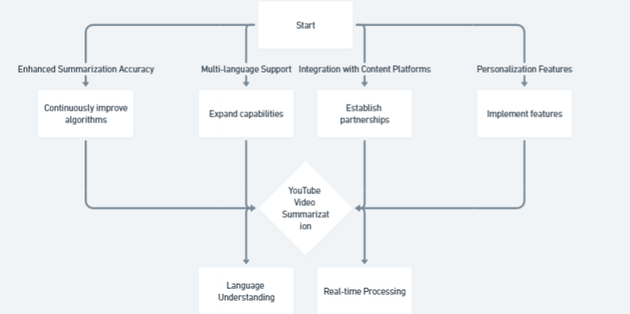
MODELLING

Slide 11
RESULTS
Extensive user testing and feedback validate the effectiveness and usability of our solution across diverse user demographics and content genres.
Metrics such as accuracy, speed, and user satisfaction demonstrate the tangible benefits of adopting the YouTube Video Summarizer.
Ongoing research and development efforts aim to further enhance the capabilities of our platform, ensuring continuous improvement and innovation.

